Slide 1
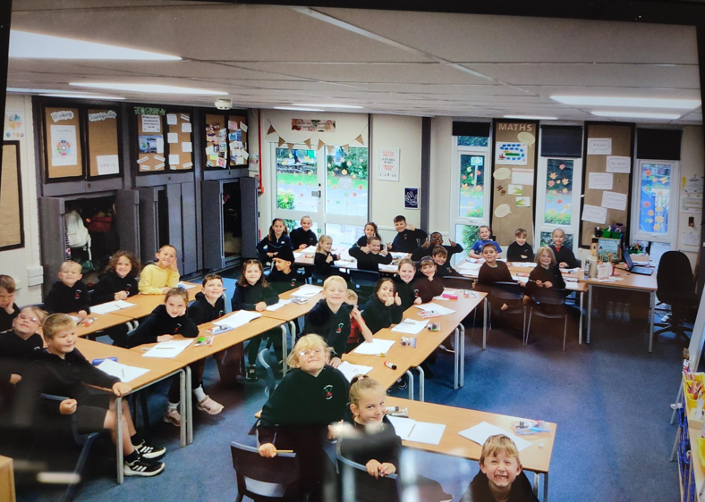
Welcome to Elm class
Year 3
Planting dreams, nurturing hearts, growing minds.

Slide 2
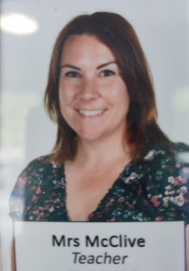
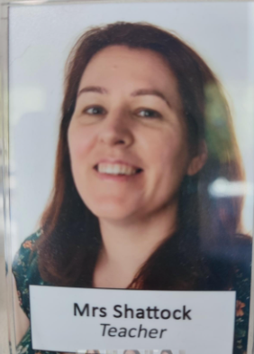
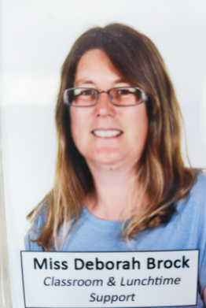
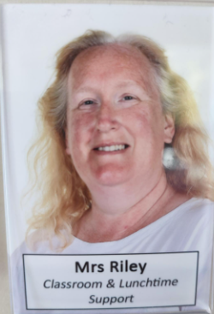
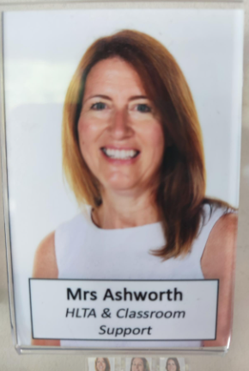
Meet the team
Planting dreams, nurturing hearts, growing minds.

Slide 3
Our routines and organisation
Children should bring a named water bottle, healthy snack and their reading folders daily.
PE Days – Friday (all year) and Thursday (Term 1,3,4,5 &6)
Forest School – Tuesday (Term 2 only)
Reading Books Changed – Wednesday
Poetry Journal Returned - Monday
On PE days, children should wear PE kit. Please note ALL long hair should be tied back and earrings must be removed.
Planting dreams, nurturing hearts, growing minds.

Slide 4
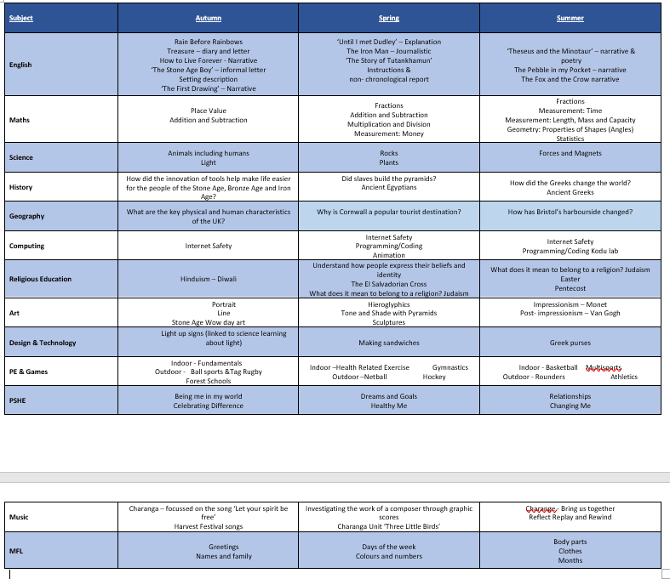
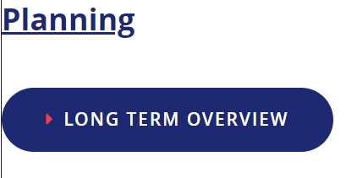
Our curriculum
A clearer and downloadable version of our Long Term Plan can be found on the year group page of the school website.
Planting dreams, nurturing hearts, growing minds.

Slide 5
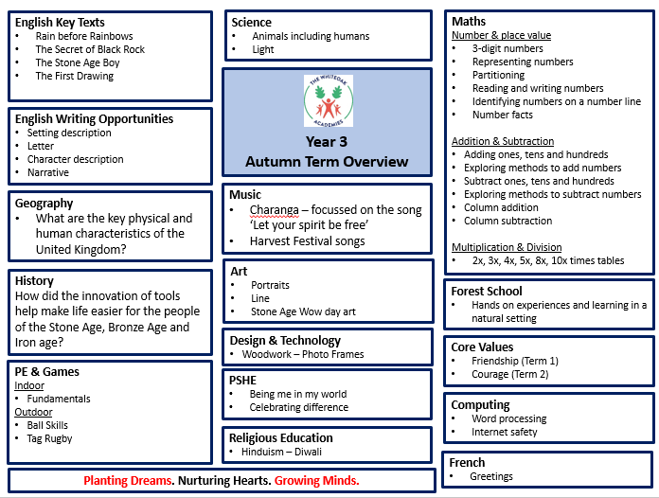
Our curriculum
Planting dreams, nurturing hearts, growing minds.

Slide 6
The Whiteoak Reading Spine
Planting dreams, nurturing hearts, growing minds.

Slide 7
The importance of reading
“Reading for pleasure is the single biggest factor in success later in life, outside of an education. Study after study has shown that those children who read for pleasure are often the ones who are most likely to fulfil their ambitions. If your child reads, they will succeed – it’s that simple.” Bali Rai, author
We ask that all children, regardless of age or ability, read aloud to an adult and share ideas about a text at least 4 times each week.
Please also continue to read to your child – even when they can read well themselves. This time together, sharing a story or non-fiction text, is a really powerful way of connecting, developing vocabulary and deepening their understanding of not only the book but the world around them.
Planting dreams, nurturing hearts, growing minds.

Slide 8
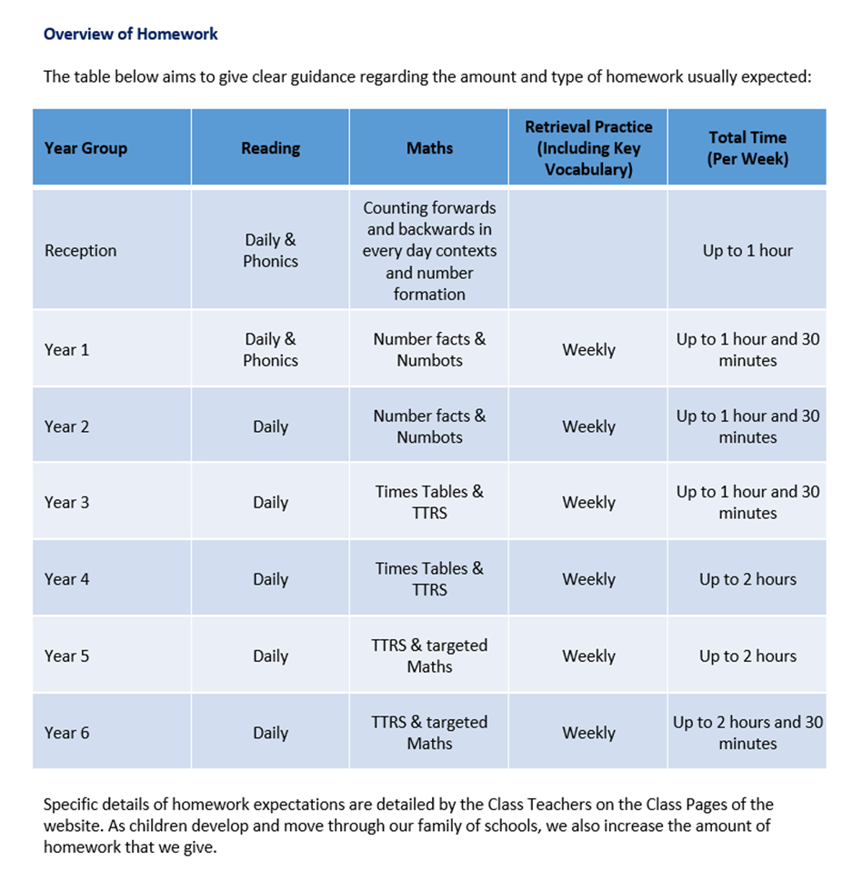
Homework
Homework in Year 3
Our school Homework Policy can be found under Curriculum Policies
In Year 3, pupils are encouraged to engage with up to 1 hour and 30 minutes homework a week.
This should consist of:
Home reading, ideally a short burst daily but a minimum of 4 reads per week. This should be recorded by an adult in the home reading record.
Maths – TT Rockstars
Retrieval practice – Various activities will be set by the teacher to help the children to consolidate the learning they are doing in class. This will include the use of the Knowledge Organisers and Science Glossaries.
Planting dreams, nurturing hearts, growing minds.

Slide 9
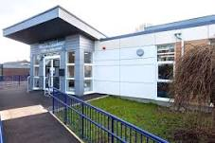
Keeping in touch
It is really important to us to have open lines of communication so that we can work successfully in partnership with parents and families.
Where concerns or questions require a more detailed conversation, teachers and families are asked to arrange a phone call or meeting at a mutually convenient time in school.
For more urgent enquiries and messages, please do phone the school office where the team will be happy to help.
Class announcements will be made through Studybugs. To contact us directly, please use the year group email:
intake21@hannahmoreandgrove.co.uk
Planting dreams, nurturing hearts, growing minds.

